Slide 1
Network Science SICSS Summer School

Slide 2
Program
09:00–10:30:
Introduction to networks
Types of analysis
Networks in Python
11:00–12:00:
Network representation
Linear algebra
12:30–14:20 (Eszter Bokányi):
POPNET
Multilevel networks
CBS applications
14:40–17:00:
Working on exercises (groups)
Gephi

Slide 3
Introduction to networks

Slide 4
Network game
Introduce yourself, and find one thing you have in common:
Countries (apart from the NLD) that you have lived in
Favorite cuisine
Sports you practice
Programming languages you use
…
Draw a line in the whiteboard, write the names in this spreadsheet: https://tinyurl.com/network-game

Slide 5
What is a network?
Mathematical representation of the relationships (edges) between entities (nodes)
The most important question to ask yourself:
What are the nodes and what are the edges?
Notes:
You can think of many things as a newtork. Social networks….

Slide 6
Types of networks
Network | Nodes | Edges
Friendship | People | Friendships
Follower | Online accounts | Followers/likes
Psychological | Symptoms | Co-ocurrence
Gene regularory | Genes | Activations/inhibations
Food web | Animals | Predating
Trade | Countries/companies | Money flows
Ownership | Companies | Ownership stakes
Internet | Computers (IPs) | Data transmission
Power grid | Power stations | Power lines
Airplane network | Airports | Flights
Social
Biology
Economic
Intrastructure
https://aaronclauset.github.io/courses/5352/csci5352_F21_L1.pdf
Notes:
Networks are present in all aspects

Slide 7
Type of networks and characteristics
Type 1: Interaction and flow → “Real networks”.
Offline interactions
Online interactions
Type 2: Affiliation → Node 1 is part of/related to node 2
Most administrative data: e.g. students in classrooms
Bipartite networks
Type 3: Co-occurrence → Node 1 is correlated with node 2
Stock market networks
Brain networks
What about family networks?

Slide 8
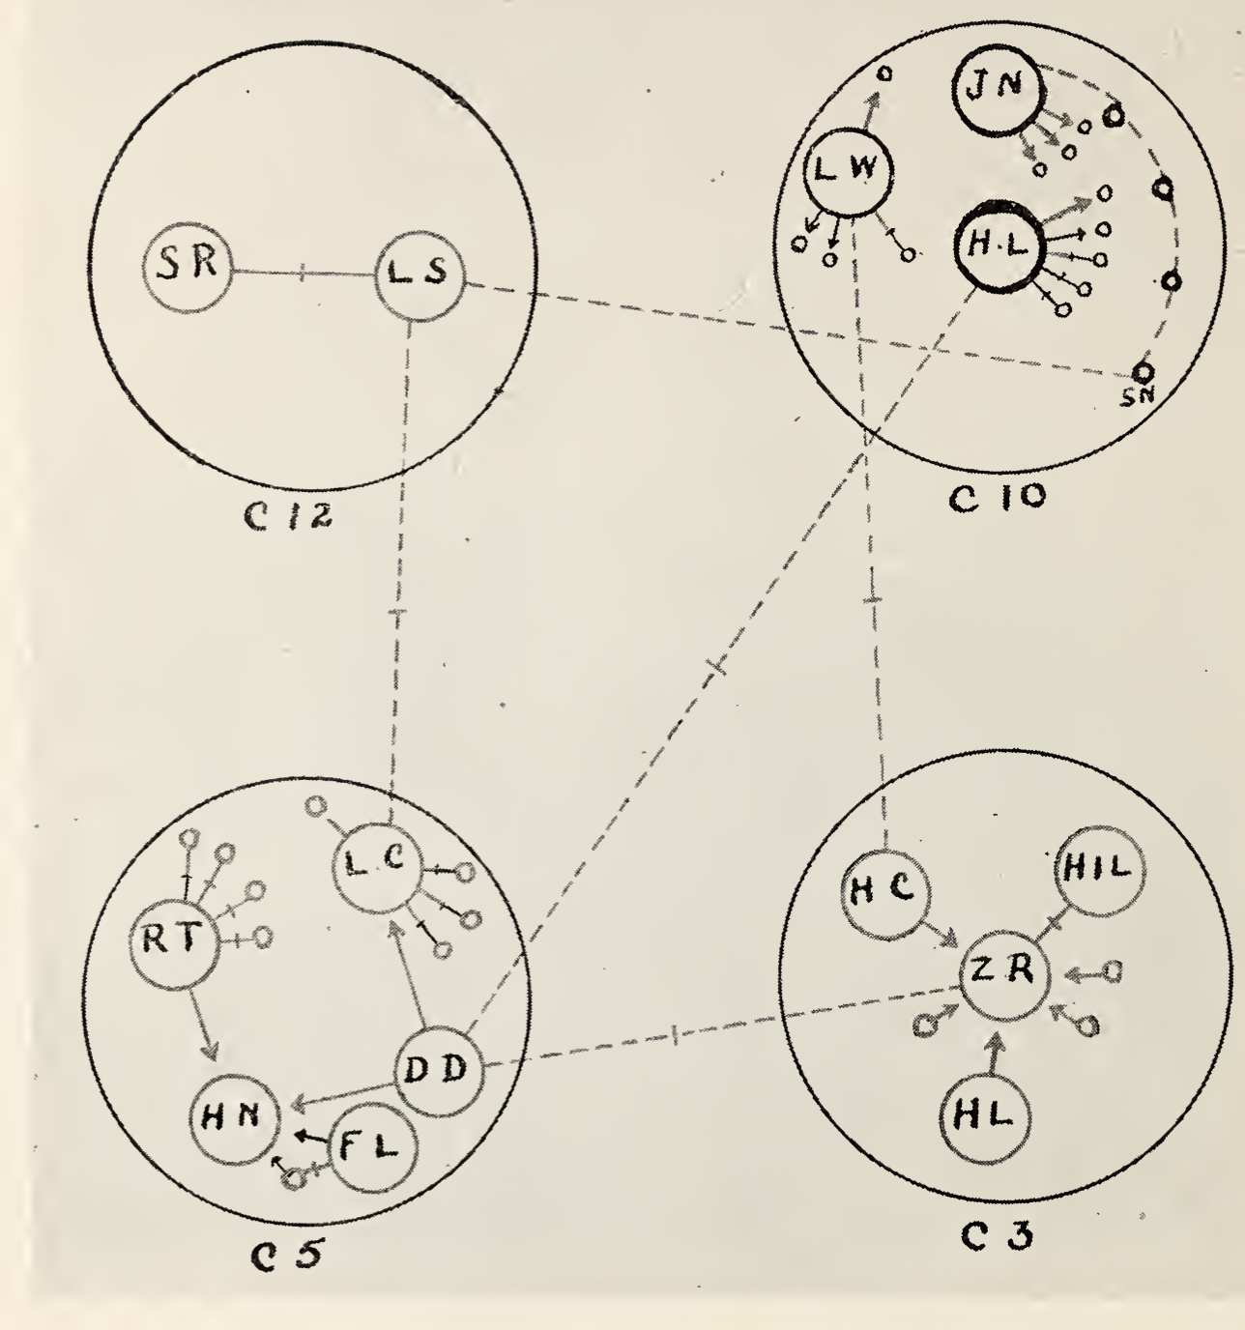
Brief history of social network science:
Mathematical representation of an underlying system (not the system itself)
Network science: Social and behavioral scientists in the XX century (e.g. Jacob Moreno & Hellen Hall Jennings, Harrison White, Mark Granovetter)
Hellen Hall Jennings and Jacob Moreno (1930s): Hudson School for girls: Sociometry. Networks can represent the systems and how information spreads
Jeffrey Travers and Stanley Milgram’s (1969): Small-world studies
Nancy Howell (1969): The Search for an Abortionist, women acquired scarce information through short chains of weak ties.
Mark Granovetter (1973) The Strength of Weak Ties. Diffusion of information takes place primarily through bridges (weak ties). Strong links are redundant.
Harrison White (1976): Blockmodels for networks
Duncan Watts, Steven Strogatz (1998): Next wave of network science
Moreno. Who shall survive?

Slide 9
Why do we care?
Theoretical links to social science (dangerous generalizations below!):
Social capital: The position of an individual in their social network (embeddeness) determines opportunities and outcomes.
Network measures map to social theories: e.g. structural holes and network closure (Burt, 2001)
Structural holes: social capital is created by a network in which people can broker connections between otherwise disconnected segments ~ betweenness centrality
Network closure: social capital is created by a network of strongly interconnected element ~ clustering coefficient
Networks:
Reflect preferences (selection)
Influence us: spread of information, diseases, opportunities

Slide 10
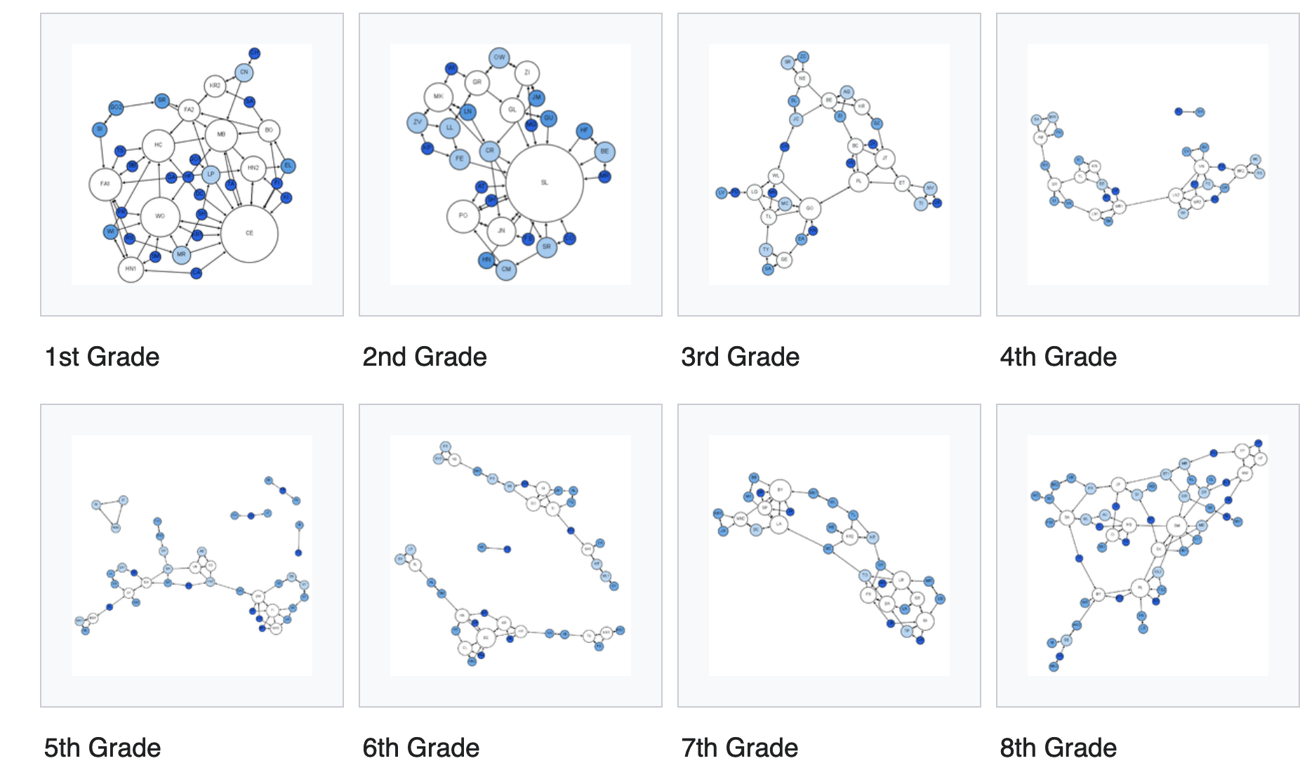
Why do we care?
Moreno, source: wikipedia

Slide 11
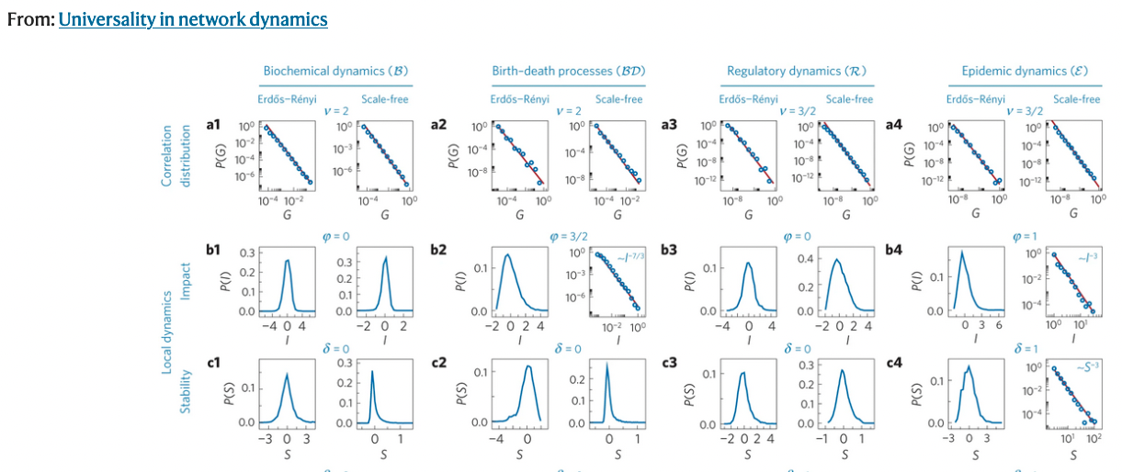
Why do we care?
Mathematical representation of an underlying system (not the system itself). Find insights that we would miss if we would study the nodes independently (one person != society)
Complex systems view (dangerous generalizations below!):
Network structure determines how information/epidemics spread
Interested in emergent behaviours:
Universality / scale-invariance (heavy tails) / fractals
Phase transitions and percolation

Slide 12
Basic definitions

Slide 13
Networks (graphs)
Nodes (vertices) connected by edges (links)
N: Nodes = {Alice, Bob, John, Amy}
E: Edges = {(Alice, Bob), (Alice, John), (John, Amy)}
The edge (i,j) connects node i to node j
Nodes can have attributes (e.g. gender, income, etc)
Edges can have attributes (e.g. type, strength, etc)
Bob
(100)
Alice
(100)
John
(20)
Amy
(10)

Slide 14
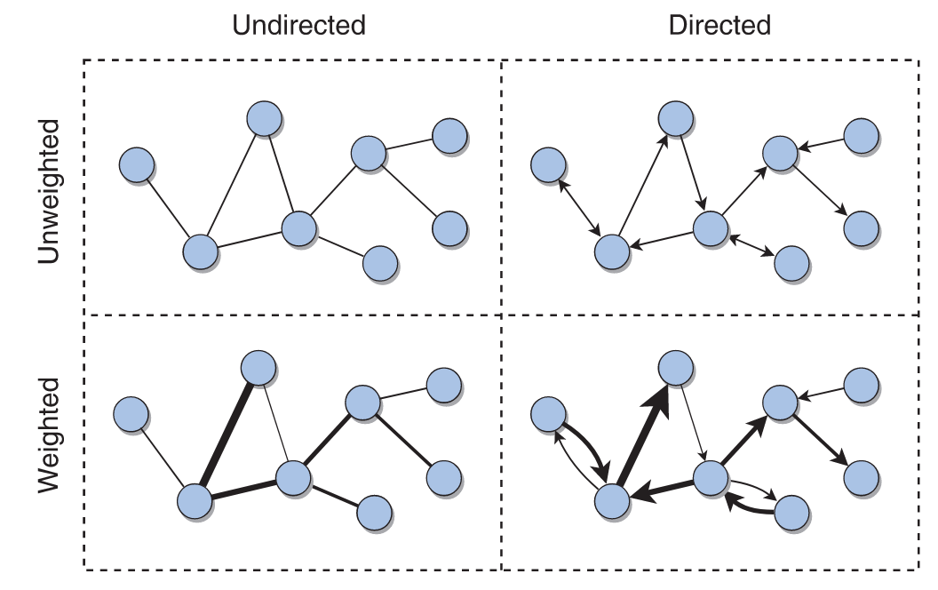
Directed vs undirected; weighted vs unweighted
Undirected: The link (i,j) connects node i to node j in both directions
Directed: The link (i,j) connects node i (source) to node j (target)
Weighted: There is a weight associated to each edge
Source: A first course in network science (2020)

Slide 15
Degree in undirected networks
Definition: Number of neighbors in the network
Node: degree
Alice: 2
Bob: 1
John: 2
Amy: 1
Bob
(100)
Alice
(100)
John
(20)
Amy
(10)

Slide 16
Degree in directed networks
Out-degree: Number of outgoing edges
In-degree: Number of incoming edges
Total degree: Sum of out and in degree
Node: (out, in, total)
Alice: (2, 0, 2)
Bob: (0,1, 1)
John: (0,2, 2)
Amy: (1,0, 1)
Bob
(100)
Alice
(100)
John
(20)
Amy
(10)

Slide 17
Other types of networks: Multiplex
Bob
Alice
John
Amy
Bob
Alice
John
Amy

Slide 18
Other types of networks: Signed
Structural balance
Bob
(100)
-1
Alice
(100)
John
(20)
+1
-1
Amy
(10)

Slide 19
Other types of networks: Temporal
Either:
Snapshots
Time of events
Bob
Alice
John
Amy
Time = 1
Bob
Alice
John
Amy
Time = 2

Slide 20
Other types of networks: Bipartite
Alice
(100)
Bob
Alice
Project
John
Bob
(100)
School 1
Amy
John
(20)
School 2
Project
School 1
School 2
Amy
(10)
Unipartite projections
Bipartite

Slide 21
Other types of networks: Multipartite
Bob
Alice
Bob
(100)
John
Amy
Work 1
Alice
(100)
School 1
Project
Bob
John
(20)
Alice
Work 2
John
School 2
Amy
(10)
Amy
Multipartite network
Multiplex projection

Slide 22
Other types of networks: Ego-networks
Bob
(100)
Alice
(100)
John
(20)
Ego network of Alice at depth 1
Bob
(100)
Alice
(100)
John
(20)
Bob
(100)
Amy
(10)
Alice
(100)
Mei
(1)
John
(20)
Amy
(10)
Ego network of Alice at depth 2

Slide 23
Other types of networks: Clique
Bob
(100)
Alice
(100)
John
(20)
Amy
(10)

Slide 24
Network characteristics

Slide 25
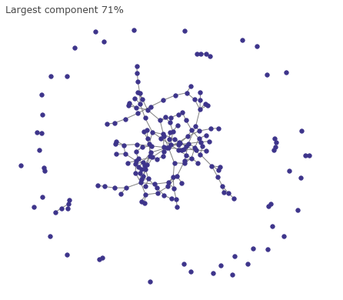
Connectedness
Real networks are typically connected, forming a “giant component”
If the average degree < 1 → many small components
If the average degree > 1 → suddenly the system becomes connected
Let’s try this!

Slide 26
Small world: six degrees of separation
Milgram’s experiment: six degrees of separation
Strogatz, Watts: small number of random links are enough to create small world networks
Shortest path between node 1 and node 2:
Minimum number of steps requires to go from node 1 to node 2
Between Alice, Amy → 2
Diameter:
Longest “shortest path” between two nodes
In our network: 2 (Alice -> John -> Amy)
Real networks have small diameters
Bob
Alice
John
Amy

Slide 27
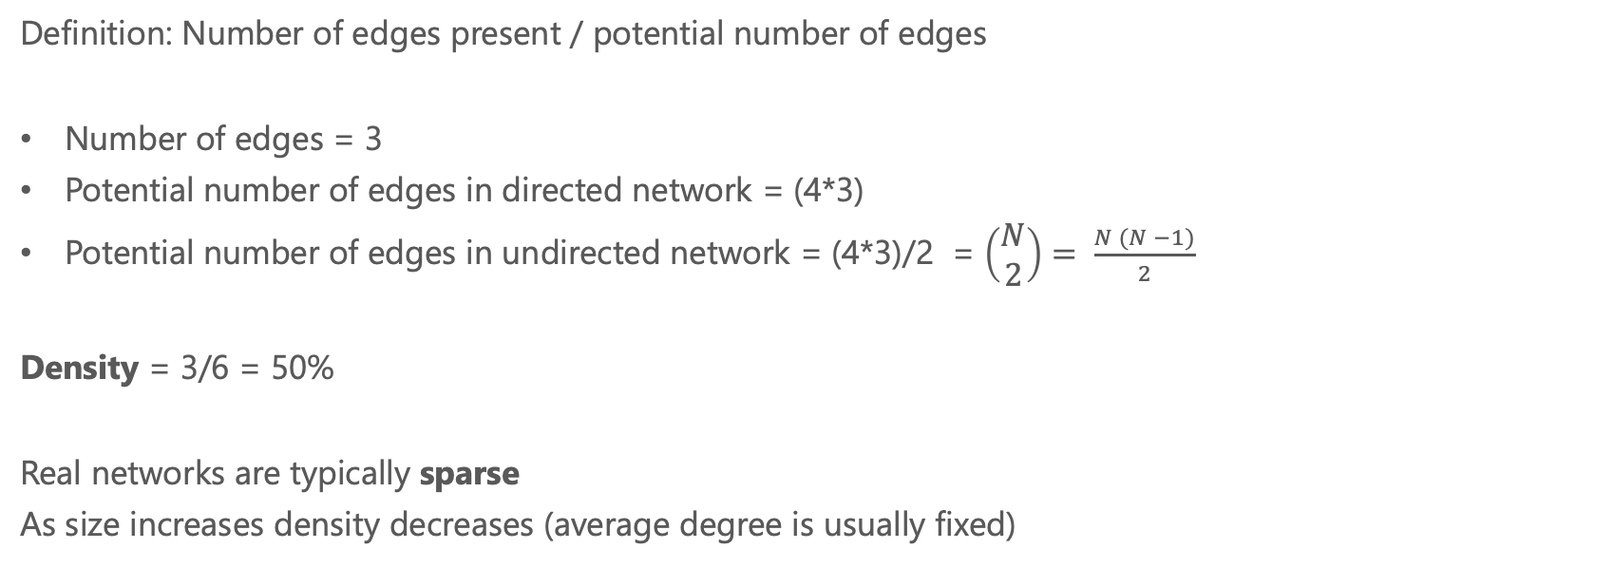
Density
Bob
Definition: Number of edges present / potential number of edges
Number of edges = 3
Potential number of edges in directed network = (4*3)
Potential number of edges in undirected network = (4*3)/2 = $\left(\begin{matrix}N \\ 2\end{matrix}\right)= \frac{N (N −1)}{2}$
Density = 3/6 = 50%
Real networks are typically sparse
As size increases density decreases (average degree is usually fixed)
Alice
John
Amy

Slide 28
Local clustering (~transitivity)
Strogatz, Watts (1998): How many of your neighbors are connected to each other
Average clustering of a network: Average clustering of the nodes
Real networks have high clustering
Clustering of Alice:
Bob
Bob
Bob
Bob
Alice
Alice
Alice
Alice
John
John
John
John
Amy
Amy
Amy
Amy
0/3
1/3
2/3
3/3

Slide 29
Reciprocity
Directed networks
Ratio of the number of edges pointing in both directions to the total number of edges in the graph.
Bob
Bob
Alice
Alice
John
John

Slide 30
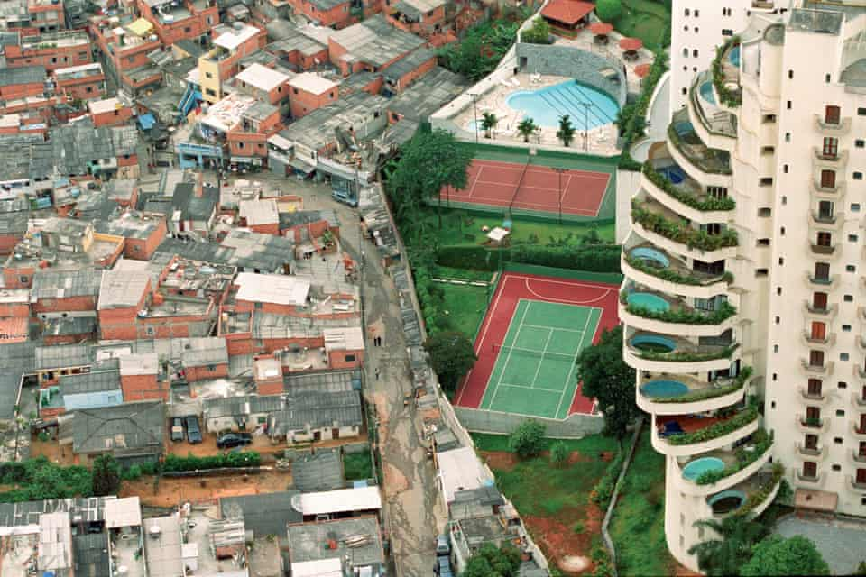
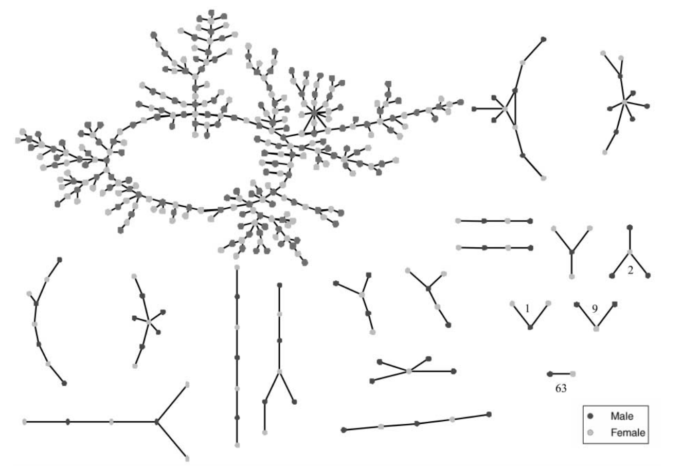
Assortativity (homophily)
Preference for nodes to attach to others that are similar in some way
Paraisópolis favela and Morumbi, in São Paulo
Photography by Tuca Vieira (the guardian)
Romatic links between teenagers
Bearman, Moody, Stovel (1991)v

Slide 31
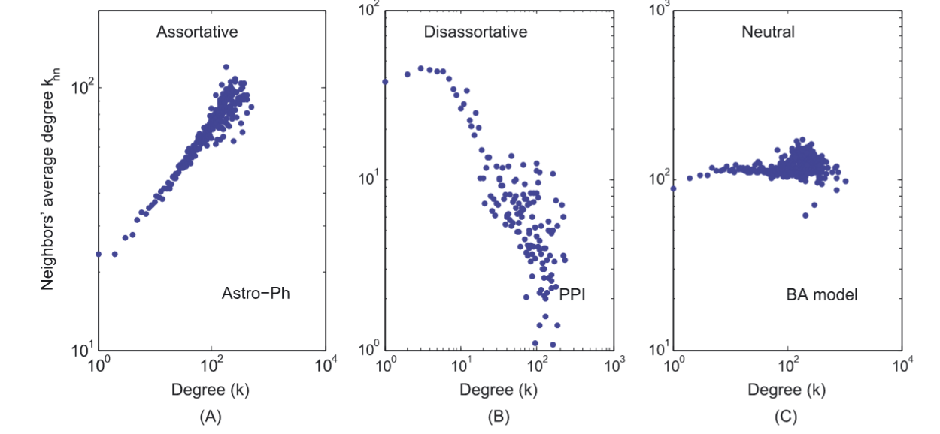
Assortativity (homophily)
At the network level:
Categorial unordered variable: = Modularity
(Actual links between edges between nodes of same type – expected number of links between nodes of same type)/number of links
Continuous variable: Pearson’s correlation across edges.
Mixing patterns in networks, Newman, Physical Review E, 67 026126, 2003
At the local level:
Real networks can be locally assortative or disassortative
Exercise: Draw a degree-assortative network
Multiscale mixing patterns in networks, Peel, Delvenne and Lambiotte (2018)
Jiang et al (2016)

Slide 32
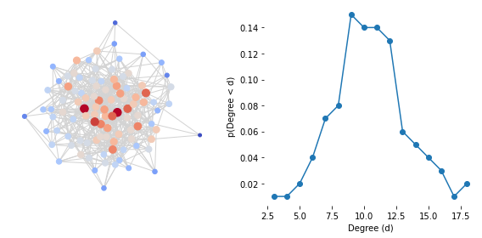
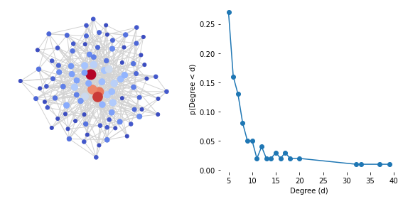
Heavy tails / scale-free
Networks are not random, they have heavy degree distributions
PDF (probability density function)
→ Degree vs probability of degree
Represented by histogram
Many possible mechanisms:
Multiplicative growth
Preferential attachment (Rich get richer, Mathew effect)
Copying models
Growing networks: https://www.stat.cmu.edu/~cshalizi/networks/16-1/lectures/08/li.pdf
Random network
Scale-free network

Slide 33
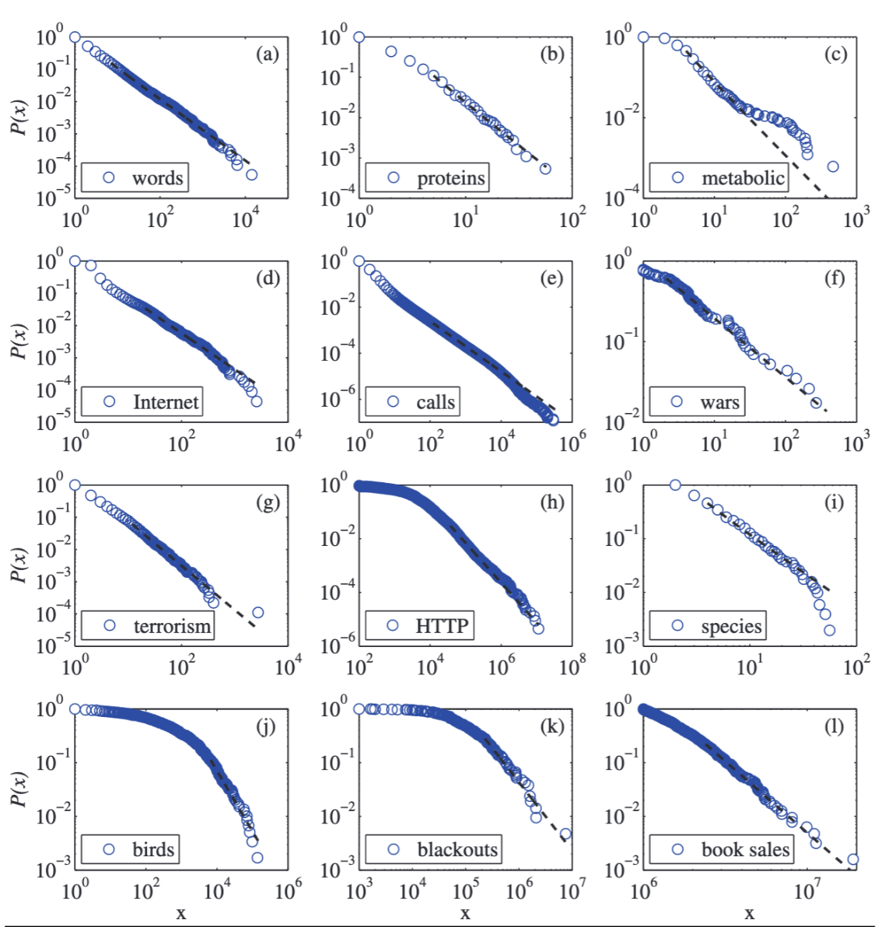
Heavy tails
Most complex systems have heavy tail distributions
Most real networks have heavy tail degree distributions
Bob
Alice
John
Amy
Clauset, Shalizi & Newman (2009)

Slide 34
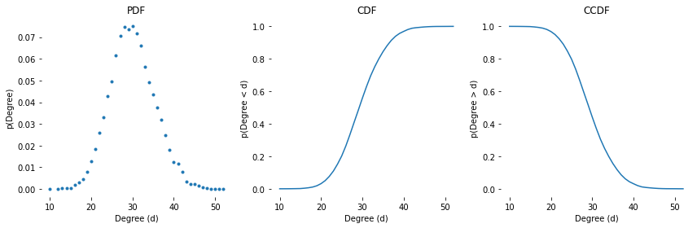
Random networks don’t have heavy tails
PDF (probability density function)
→ Degree vs probability of degree
→ Represented by histogram
CDF (cumulative density function)
→ Degree s vs probability degree < s
CCDF: Complementary CDF
→ Degree s vs probability degree > s

Slide 35
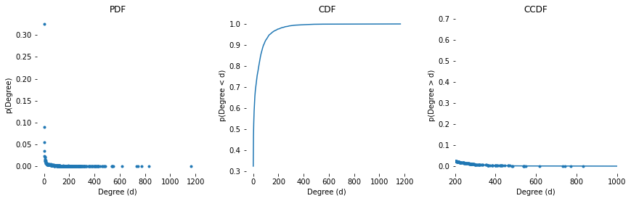
Random network
Real network (Wikipedia mentions)

Slide 36
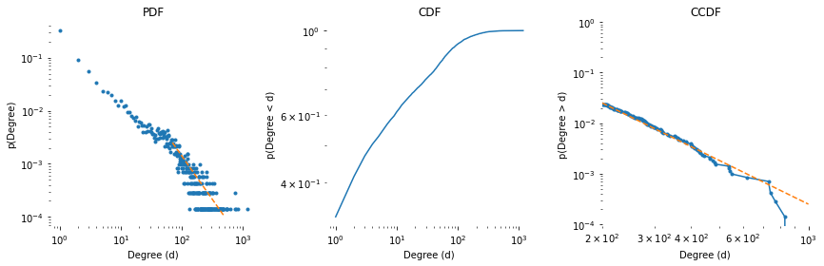
Random network
Real network (Wikipedia mentions)

Slide 37
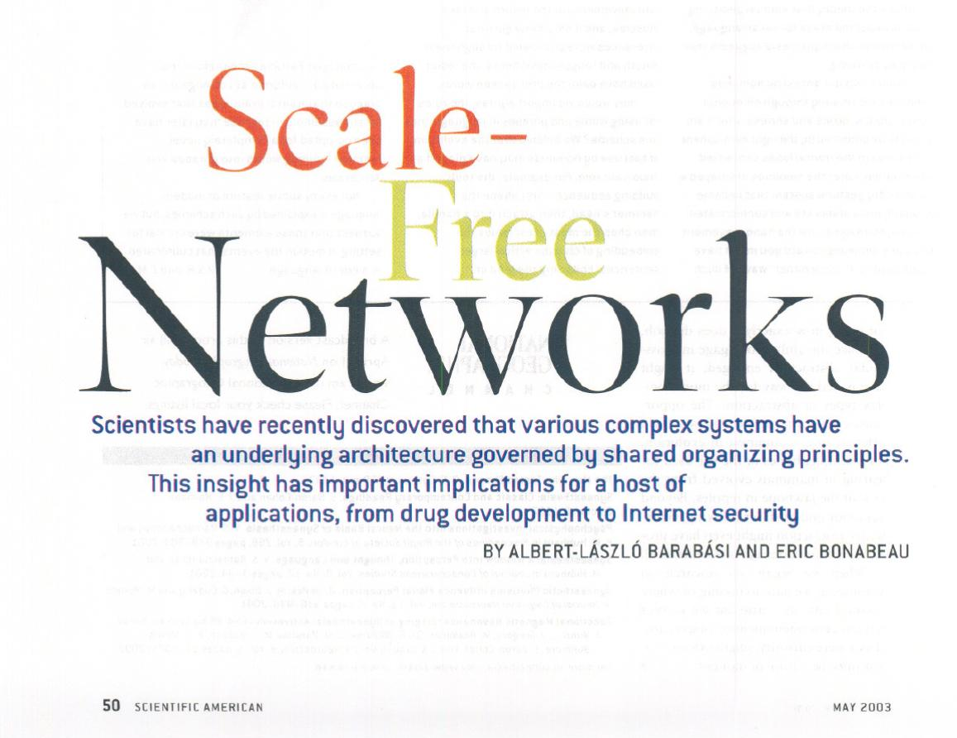

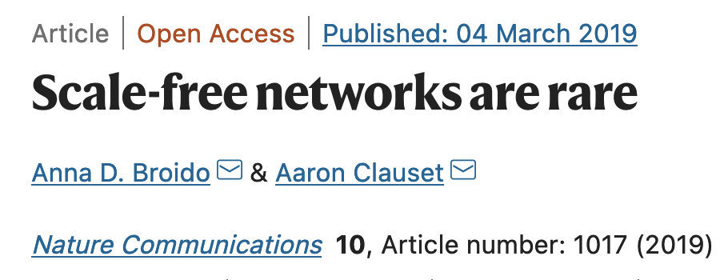

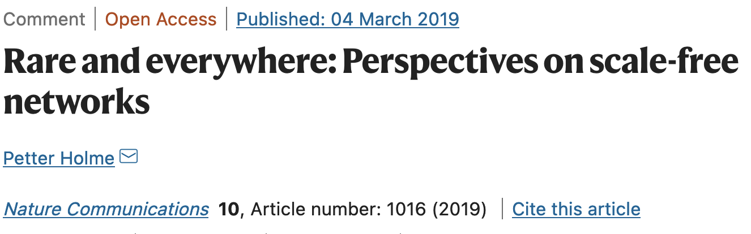
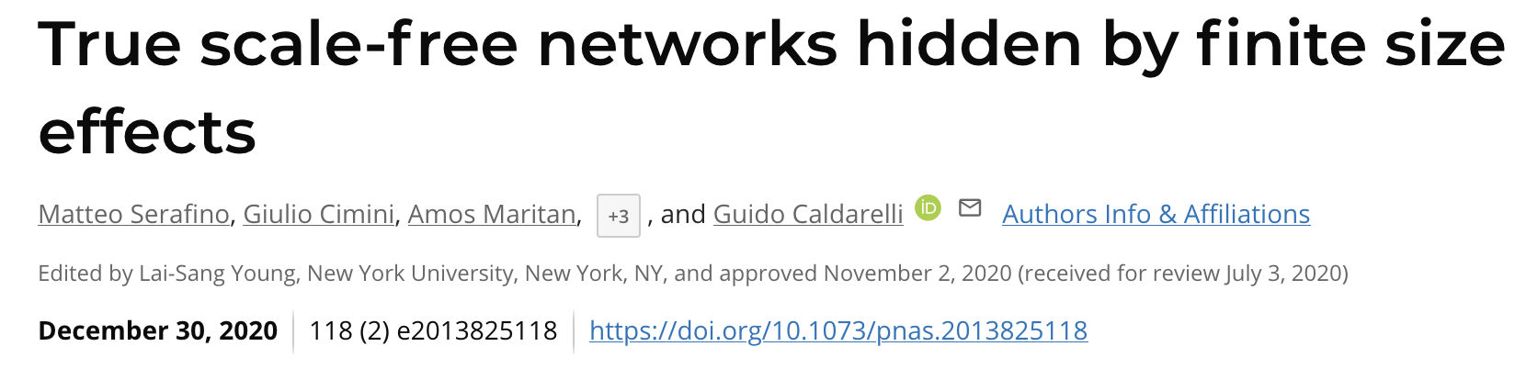
Is it a power-law? P(d) ~ d^{-⍺}

Slide 38
Robustness to failures Fragility to targeted attacks
Random network
Power-law network

Slide 39
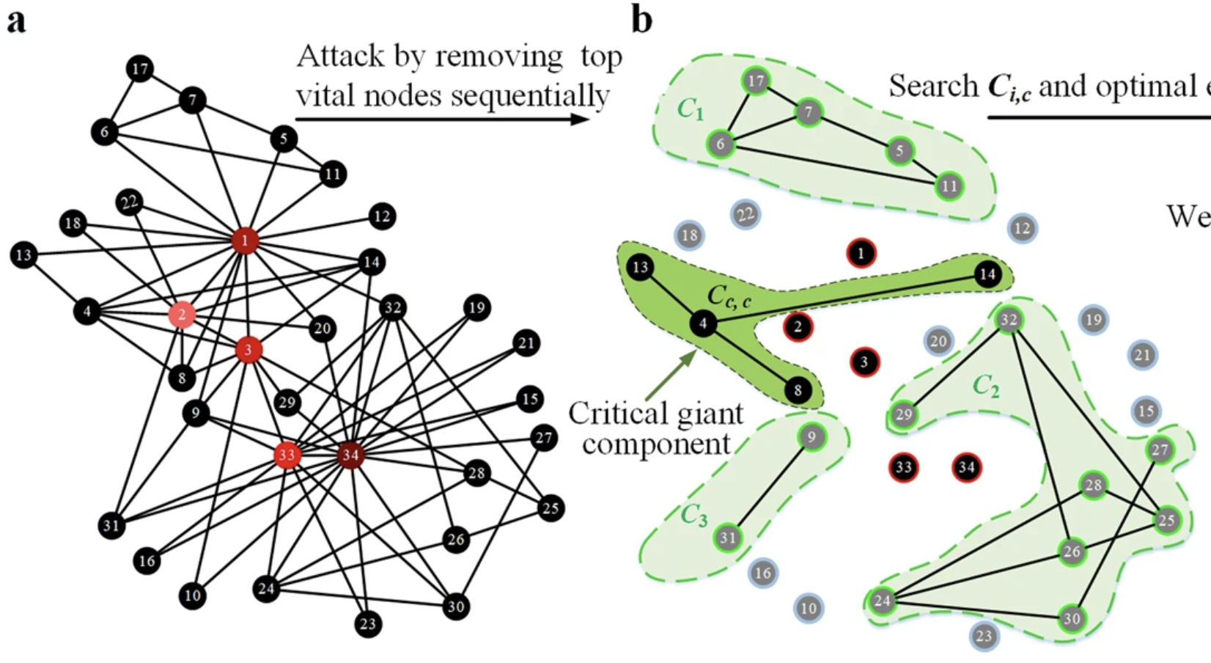
Robustness to failures Fragility to targeted attacks
Albert, Jeong, Barabasi (2000) Attack and error tolerance of complex networks
Li et al (2011)

Slide 40
Affiliation networks

Slide 41
Bob
(100)
How does the CBS newtorks look like?
Giant component → Most nodes are connected
Small world → Small diameter
Low density → Low average degree
Form cliques! (high clustering/transitivity)
Assortative (homophilic)
Heavy tail distributions
Work 1
Alice
(100)
School 1
John
(20)
Work 2
School 2
Amy
(10)
Multipartite network

Slide 42
Types of analysis
They should fit your research question

Slide 43
Types of analysis: Descriptive statistics
Describe the network characteristics (density, diameter, average degree, clustering, etc)

Slide 44
Types of analysis: Centralities
What are the most important nodes in the network?
The one with more connections → Degree centrality
DegreeC ~ degree
The one linked to more important neighbors → Pagerank / Eigenvector / Katz centrality
PagernakC intuition ~ (alpha)*Pagerank_neighbors + (1-alpha)*Baseline
The one closest to all other nodes → Closeness centrality
ClosenessC ~ 1/sum(shortest path to all other nodes)
The ones that act as brokerage? → Betweeness centrality
BetweenessC ~ number of shortest paths going through the node

Slide 45
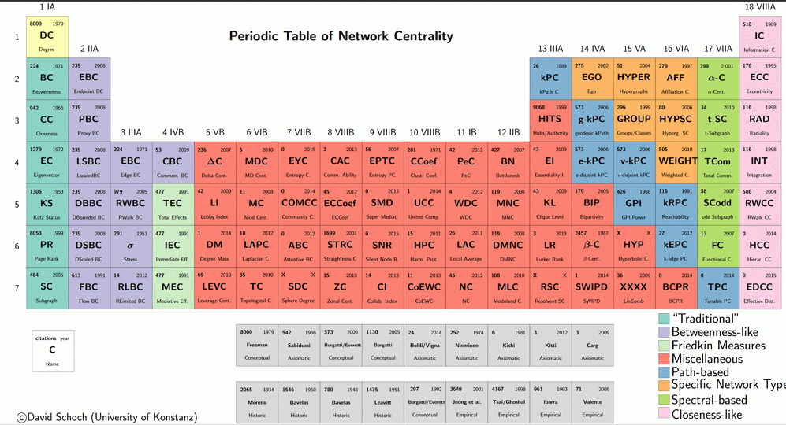
Use a centrality measure that fits your theory, not the one that gives you the best results
Consider what is the objective (e.g. is it to enable low-income individuals to increase their social capital?) (https://petterhol.me/2019/01/11/the-importance-of-being-earnest-about-node-importance/)

Slide 46
Types of analysis: Node-level regression
Calculate node-level features:
Centrality
Local clustering (transitivity / embededness)
Local reciprocity
Local assortativity (homophily)
…
Include in your model (e.g. a regression)

Slide 47
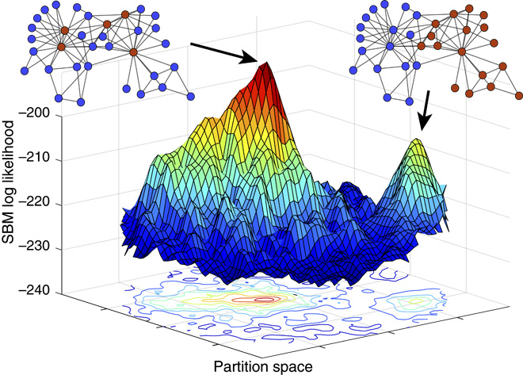
Types of analysis: Community detection
What clusters of nodes can we find in the network?
“It is standard practice to treat some observed discrete-valued node attributes, or metadata, as ground truth. We show that metadata are not the same as ground truth and that treating them as such induces severe theoretical and practical problems. We prove that no algorithm can uniquely solve community detection, and we prove a general No Free Lunch theorem for community detection, which implies that there can be no algorithm that is optimal for all possible community detection tasks” (Peel, Larremore, Clauset, 2017)
Stochastic Blockmodels (Harrison White, structural equivalence, core-periphery)
Modularity minimization

Slide 48
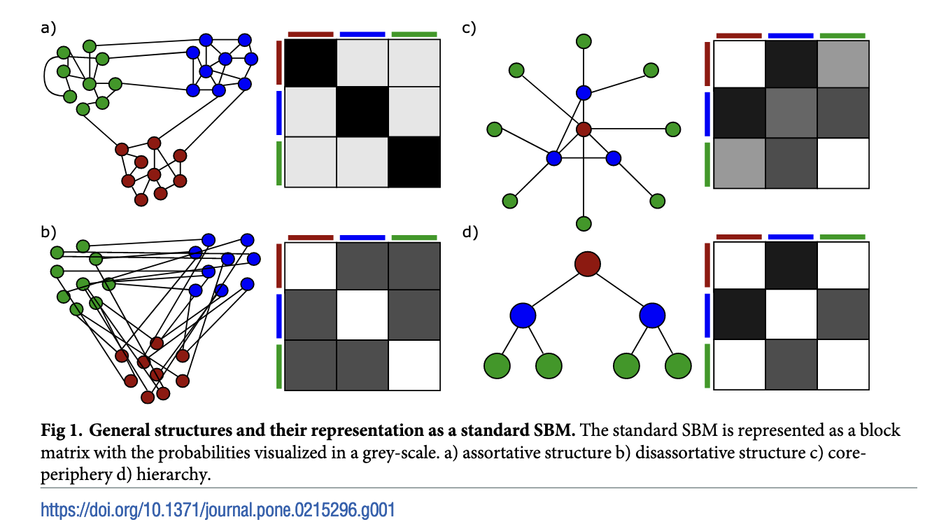
Types of analysis: Community detection and the Stochastic Blockmodel

Slide 49
Some other type of analysis

Slide 50
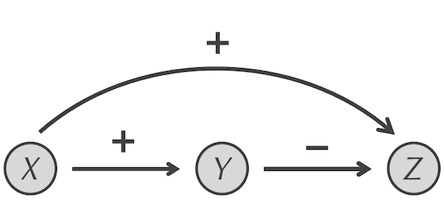
Types of analysis: Motif detection
Find overrepresented patterns
Feed-forward loop (https://biologicalmodeling.org/motifs/feedforward)

Slide 51
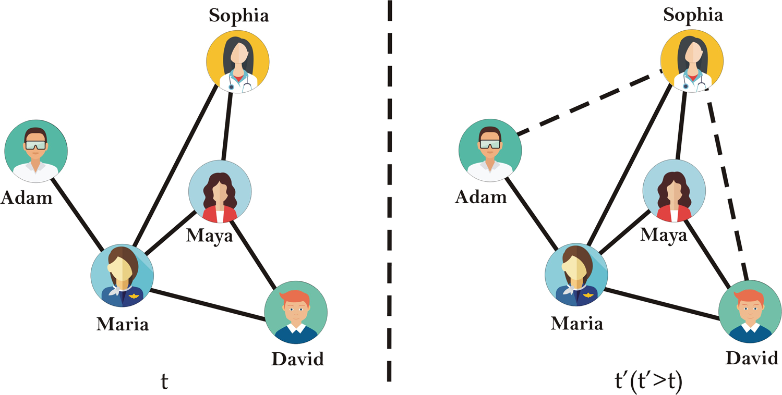
Types of analysis: Link/metadata prediction
Networks are rarely complete
Link prediction approach: Approaches such as triangle closure
Ahmad et al 2020

Slide 52
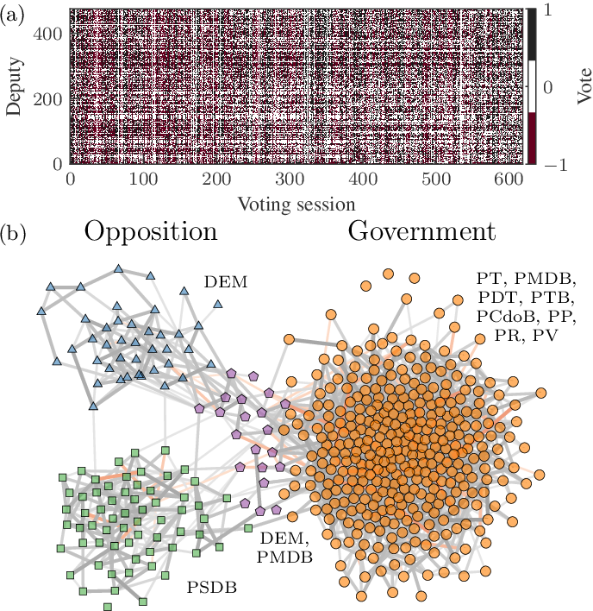
Types of analysis: Network reconstruction
Network from co-occurrences
Network Reconstruction and Community Detection from Dynamics, Peixoto 2019

Slide 53
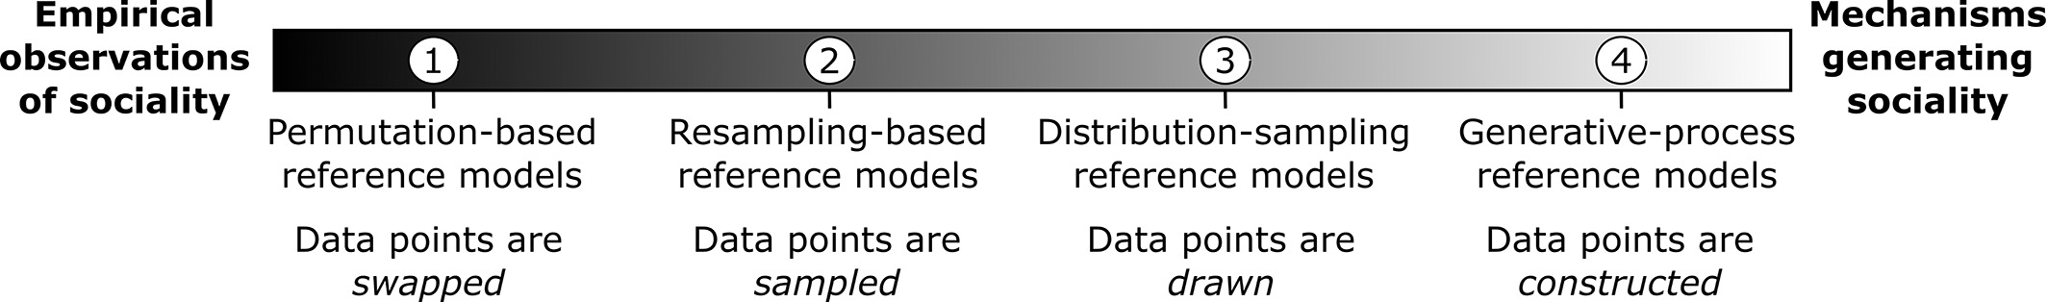
Types of analysis: Testing hypothesis
We observe some behavior in the network (e.g. the clustering is 0.5). Is this relevant?
Approach: Create a reference model (see Hobson 2021 for a great guide) to compare with it
- Configuration model (permuting edges)
- Generative models (e.g. rich get richer model)
- ERGM (which features of dyads affect the presence or strength of edges.)
- ABM
Hobson 2021

Slide 54
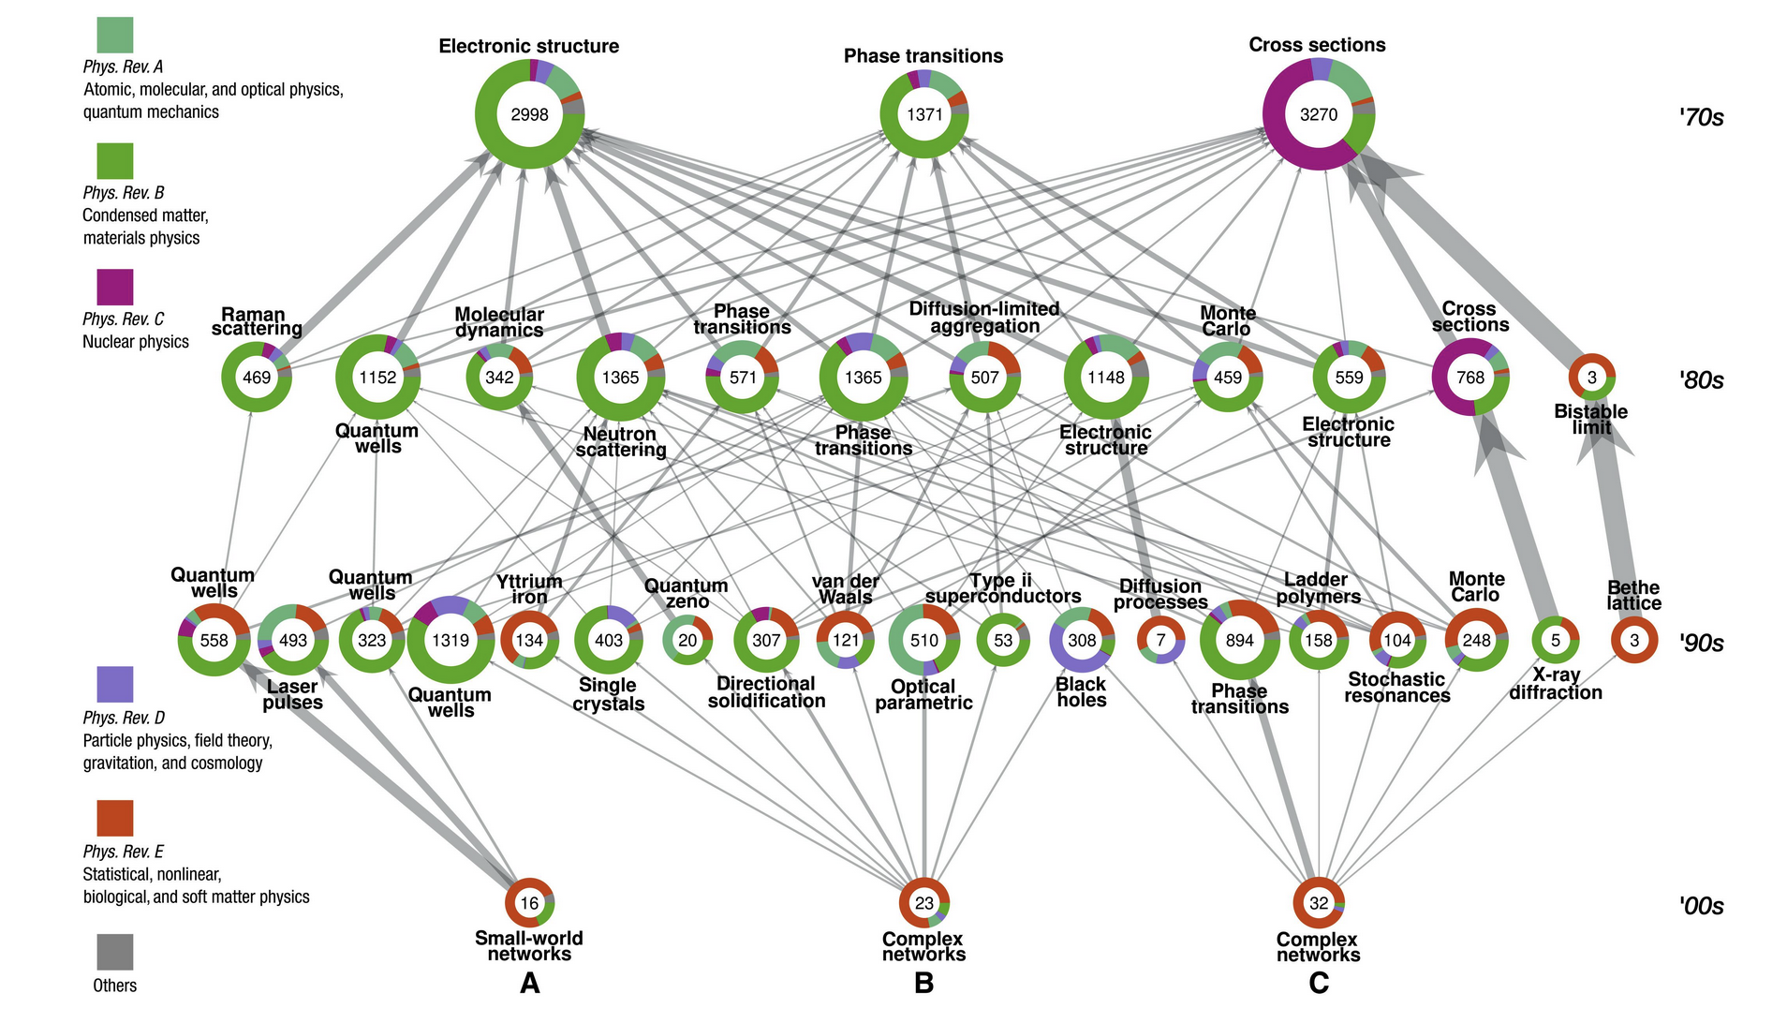
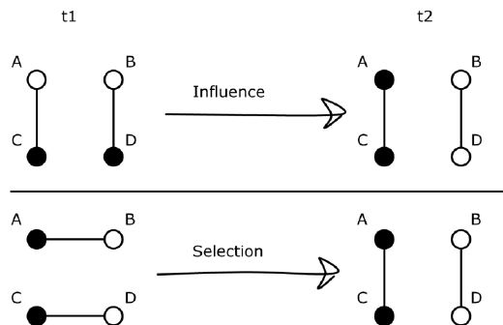
Types of analysis: Dynamics
How does behavior/diseases/information spread?
Allow to test selection vs influence
Run simulations on networks
Game theory
Epidemic spreading
Gene expression
Friemel, 2015
Bovet et al, 2022

Slide 55
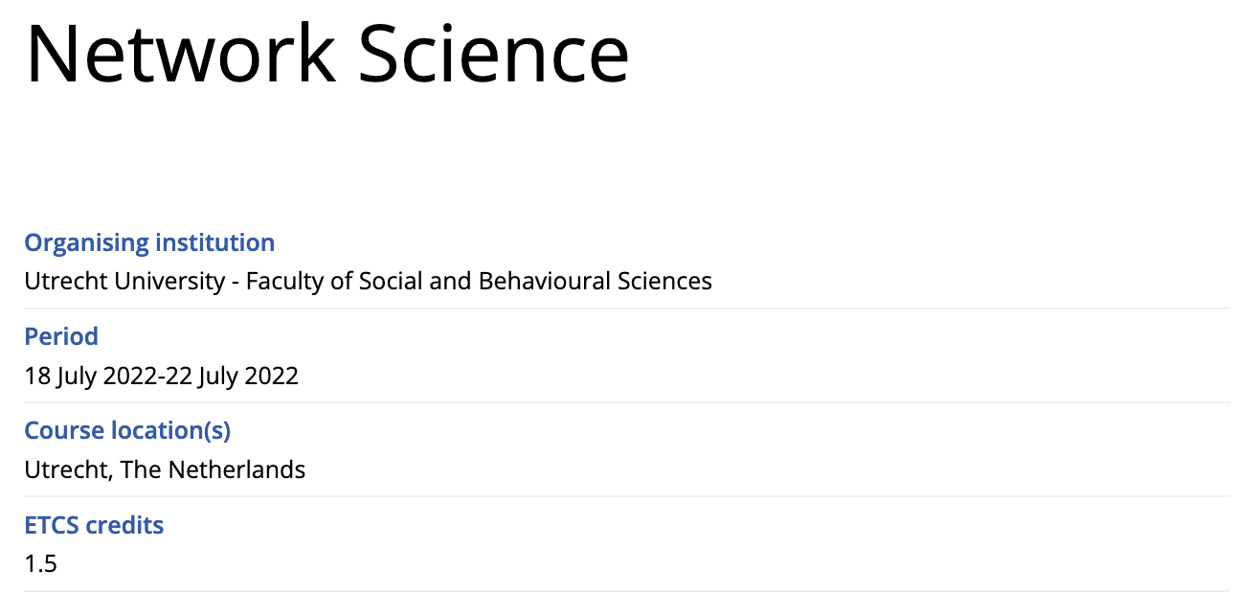
Interested ?
Deadline: July 4th
https://utrechtsummerschool.nl/courses/social-sciences/network-science

Slide 56
Matrix representation

Slide 57
Network representation
Bob
Alice
John
Adjacency list:
A. It is dense: Only keeping edges
Adjacency matrix:
A. Linear algebra is easy
Sparse: Many zeros → 1E6 nodes/10 million edges → 1 trillion options
Origin | Target | Weigth
Alice | Bob | 1
Alice | John | 1
Target → ↓ Source | Alice | Bob | John
Alice | 0 | 1 | 1
Bob | 0 | 0 | 0
John | 0 | 0 | 0
In computer → Sparse matrices: Best of both worlds

Slide 58
Practical 1: Python
1. Download materials:
https://github.com/jgarciab/one_day_network_science
(Click on Code -> Download ZIP)
2. Extract ZIP
3. Set up Python. In Windows (Mac/Linux):
Open a conda terminal (open a terminal)
Navigate to the directory with the code using dir (ls) to list the files and cd XXX (cd XXX) to enter directory XXX.
Create a new environment: conda env create -f environment.yml
Activate environment: conda activate networks
Launch jupyter notebook: jupyter notebook
Open notebook: 1_intro_networks.ipynb

Slide 59
Afternoon: Intro to linear algebra
Why? Multiplying matrices is fast (relatively)
Notes:
No way to use networkx in the server

Slide 60
Network representation
Bob
Alice
John
Adjacency list:
A. It is dense: Only keeping edges
Adjacency matrix:
A. Linear algebra is easy
Sparse: Many zeros → 1E6 nodes/10 million edges → 1 trillion options
Origin | Target | Weigth
Alice | Bob | 1
Alice | John | 1
Target → ↓ Source | Alice | Bob | John
Alice | 0 | 1 | 1
Bob | 0 | 0 | 0
John | 0 | 0 | 0
In computer → Sparse matrices: Best of both worlds

Slide 61
Directed networks
Bob
Target → ↓ Source | Alice | Bob | John
Alice | 0 | 1 | 1
Bob | 0 | 0 | 0
John | 0 | 0 | 0
Alice
John

Slide 62
Undirected networks
Bob
Target → ↓ Source | Alice | Bob | John
Alice | 0 | 1 | 1
Bob | 1 | 0 | 0
John | 1 | 0 | 0
Alice
John

Slide 63
Some terms
Target → ↓ Source | Alice | Bob | John
Alice | 0 | 1 | 1
Bob | 0 | 0 | 0
John | 0 | 0 | 0
 | 1 | 0 | 0
 | 0 | 1 | 0
 | 0 | 0 | 1
Identity matrix (I) =
I @ A = A
A =
Diagonal
Target → ↓ Source | Alice | Bob | John
Alice | 0 | 0 | 0
Bob | 1 | 0 | 0
John | 1 | 0 | 0
Transpose (A^{T}) =
(python) A.T
Trace = Sum of elements in the diagonal
Symmetric matrix: A = A.T (e.g. undirected network)

Slide 64
Python exercise notebook 2, ex.1
Python:
Convert between formats
Plot matrix

Slide 65
Matrix multiplication: sum
Bob
(100)
Alice
(100)
John
(20)
Amy
(10)
Target → ↓ Source | Alice | Bob | John | Amy
Alice | 0 | 1 | 1 | 0
Bob | 1 | 0 | 0 | 0
John | 1 | 0 | 0 | 1
Amy | 0 | 0 | 1 | 0
Node | Income
Alice | 100
Bob | 100
John | 20
Amy | 10
Node | Income
Alice | 0*100 + 1*100 + 1*20 + 0*10 = 120
Bob | 1*100 + 0*100 + 0*20 + 0*10 = 100
John | 1*100 + 0*100 + 0*20 + 1*10 = 110
Amy | 0*100 + 0*100 + 1*20 + 0*10 = 20
@
=
A @ M = SM
(N x N) @ (N x 1) = (N x 1)

Slide 66
Matrix multiplication: average
Bob
(100)
Alice
(100)
John
(20)
Divide by the degree. We get it by summing the adjacency elements column-wise (axis=1)
A @ M / A.sum(1) = AvM
(N x N) @ (N x 1) / (N x 1) = (N x 1) / (N x 1) = (N x 1)
Amy
(10)
Target → ↓ Origin | Alice | Bob | John | Amy
Alice | 0 | 1 | 1 | 0
Bob | 1 | 0 | 0 | 0
John | 1 | 0 | 0 | 1
Amy | 0 | 0 | 1 | 0
Node | Income
Alice | 100
Bob | 100
John | 20
Amy | 10
Node | Income
Alice | 120
Bob | 100
John | 110
Amy | 20
@
Node | Income
Alice | 60
Bob | 100
John | 55
Amy | 20
=
=
Target → ↓ Source | Sum
Alice | 2
Bob | 1
John | 2
Amy | 1
Target → ↓ Source | Sum
Alice | 2
Bob | 1
John | 2
Amy | 1

Slide 67
Python exercise notebook 2, ex.2

Slide 68
Matrix multiplication: paths
Bob
(100)
Alice
(100)
John
(20)
Interpretation A: Presence of path between node i and j
Interpretation A²: Number of path between node i and j in two steps
Interpretation A³: Number of path between node i and j in three steps
…
Amy
(10)
Target → ↓ Source | Alice | Bob | John | Amy
Alice | 0 | 1 | 1 | 0
Bob | 0 | 0 | 0 | 0
John | 0 | 0 | 0 | 1
Amy | 0 | 0 | 0 | 0
Target → ↓ Source | Alice | Bob | John | Amy
Alice | 0 | 1 | 1 | 0
Bob | 0 | 0 | 0 | 0
John | 0 | 0 | 0 | 1
Amy | 0 | 0 | 0 | 0
Target → ↓ Source | Alice | Bob | John | Amy
Alice | 0 | 0 | 0 | 1
Bob | 0 | 0 | 0 | 0
John | 0 | 0 | 0 | 0
Amy | 0 | 0 | 0 | 0
@
=
Alice → Alice (0) * Alice → Amy (0)
+ Alice → Bob (1) * Bob → Amy (0)
+ Alice → John (1) * John → Amy (1)
+ Alice → Alice (0) * Alice → Amy (1)

Slide 69
Python exercise notebook 2, ex.3a

Slide 70
Matrix multiplication: number of people reached in <3 steps
Number of paths in two or three steps from node i to node j: N = A + A^2 + A^3
We need to remove duplicate paths: N = N>0
We need to remove paths from us to ourselves N.setdiag(0)

Slide 71
Matrix multiplication: number of triangles
Number of paths in two or three steps from node i to node j: N = A + A^2 + A^3
We need to remove duplicate paths: N = N>0
We need to remove paths from us to ourselves N.setdiag(0)

Slide 72
Matrix multiplication: number of triangles
Bob
(100)
Alice
(100)
John
(20)
A^2
Target → ↓ Source | Alice | Bob | John | Amy
Alice | 0 | 1 | 1 | 0
Bob | 0 | 0 | 0 | 0
John | 0 | 0 | 0 | 1
Amy | 0 | 0 | 0 | 0
Target → ↓ Source | Alice | Bob | John | Amy
Alice | 0 | 1 | 1 | 0
Bob | 0 | 0 | 0 | 0
John | 0 | 0 | 0 | 1
Amy | 0 | 0 | 0 | 0
Target → ↓ Source | Alice | Bob | John | Amy
Alice | 0 | 0 | 0 | 1
Bob | 0 | 0 | 0 | 0
John | 0 | 0 | 0 | 0
Amy | 0 | 0 | 0 | 0
Amy
(10)
@
=
Alice → Alice (0) * Alice → Amy (0)
Diagonal of A³
Alice → X₁ * X₁ → X₁ * X₁ → Alice +
Alice → X₁ * X₁ → X₂ * X₂ → Alice +
…
+ Alice → Bob (1) * Bob → Amy (0)
+ Alice → John (1) * John → Amy (1)
+ Alice → Alice (0) * Alice → Amy (1)

Slide 73
Python exercise notebook 2, ex.3b

Slide 74
Python exercise notebook 2, ex.4

Slide 75
Other types of networks: Bipartite
Alice
(100)
Bob
Alice
Project
John
Bob
(100)
School 1
Amy
John
(20)
School 2
Project
School 1
School 2
Amy
(10)
Unipartite projections
Bipartite

Slide 76
Matrix multiplication: projection
Alice
Target → ↓ Source | S1 | S2
Alice | 0 | 1
Bob | 1 | 0
John | 1 | 0
Amy | 0 | 1
Target → ↓ Source | Alice | Bob | John | Amy
S1 | 0 | 1 | 1 | 0
S2 | 1 | 0 | 0 | 1
@
=
Amy
School 2
John
Target → ↓ Source | Alice | Bob | John | Amy
Alice | 1 | 0 | 0 | 1
Bob | 0 | 1 | 1 | 0
John | 0 | 1 | 1 | 0
Amy | 1 | 0 | 0 | 1
School 2
Bob
Alice → S1 (0) * S1 → Amy (0)
+ Alice → S2 (1) * S2 → Amy (1)

Slide 77
Python exercise notebook 2, ex.5

Slide 78
Practical 3: Working with networks using Gephi
Exercise 1: Gephi
Follow this tutorial (slides 1–23 only!): https://gephi.org/users/quick-start/
In community detection use the “stochastic blockmodel” instead of modularity maximization
You can choose to use our own data: https://tinyurl.com/network-game

Slide 79
Matrix multiplication: Random walks and eigenvectors

Slide 80
Python exercise notebook 2, ex.7

